Slide 1
Introduction to mobile APP development
Teacher: Dr. XU Linlin

Slide 2
Teacher Introduction
徐琳琳(Xu Linlin) Senior laboratory technician
Office: Hui Yuan Room 411 in Building 2#
TEL:13534062905
Email：xull@sustech.edu.cn
Open office hour：周二14:00~16:00

Slide 3



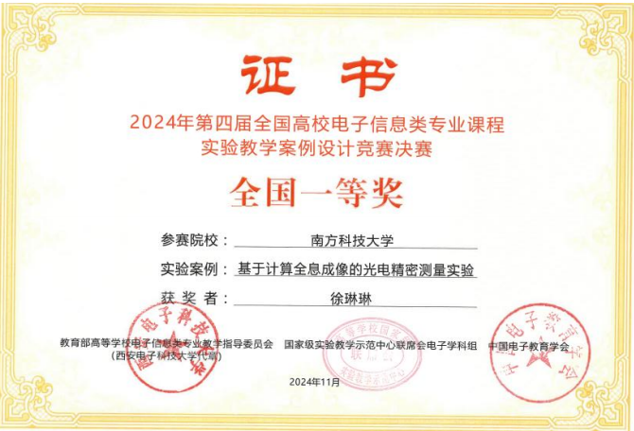

Slide 4
Content
Introduction to Andriod based mobile APP development.
Mobile APP development process.
Introduction to Andriod Studio .
Introduction to Android Studio layout and components.
Course projects .
Task.

Slide 5
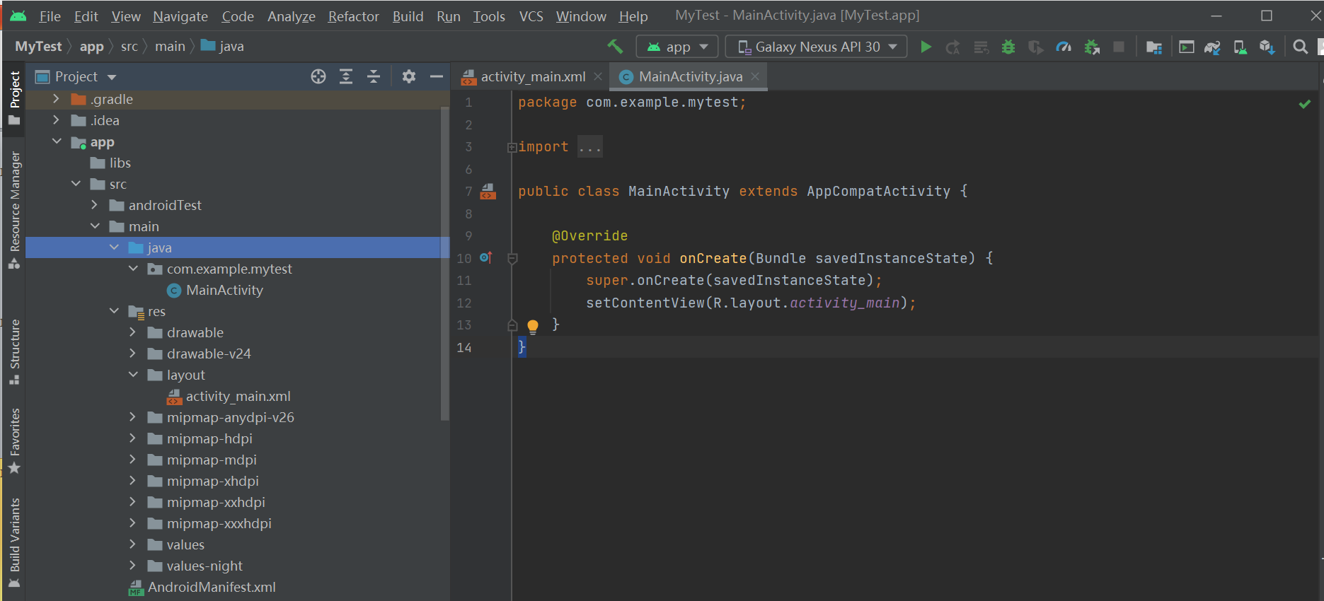
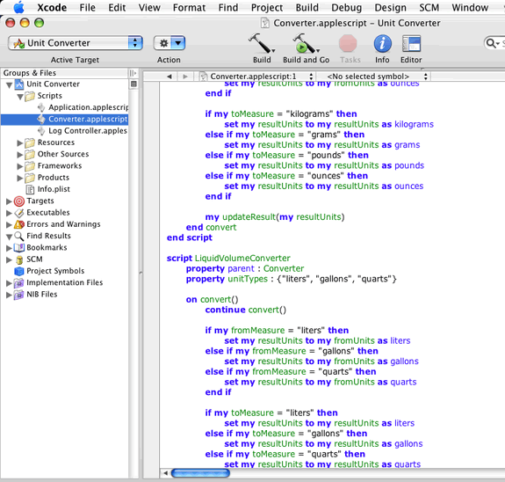
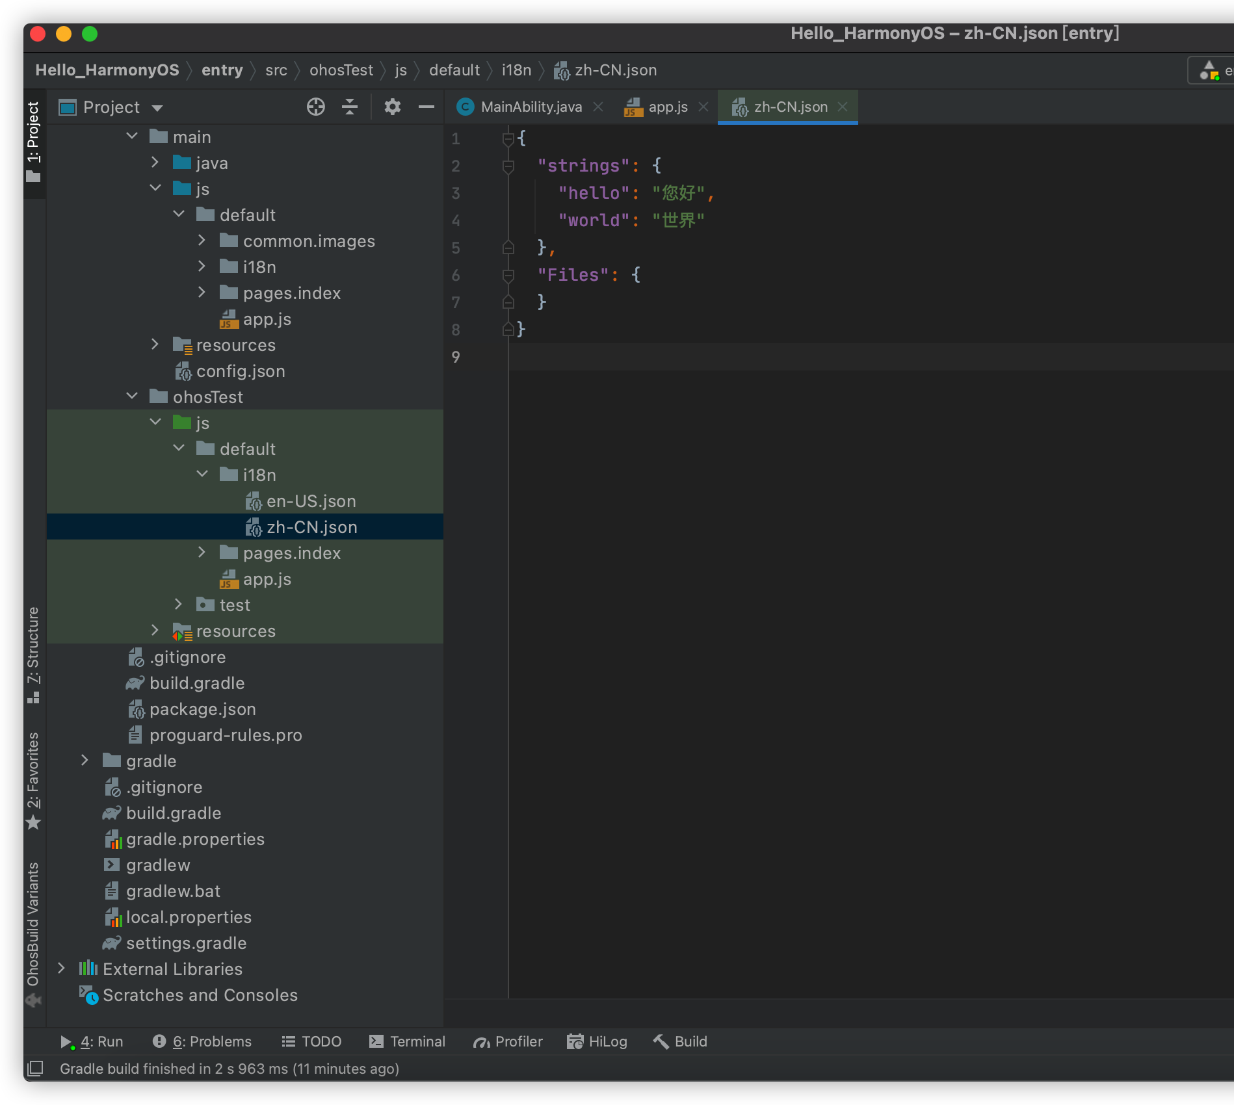
1.Introduction to Andriod based mobile APP development
2024年第三季度，国内市场中，华为HarmonyOS的份额从13%增至15%，安卓系统则从72%下降至70%，苹果iOS保持在15%。
截至2025年1月，已有超过3亿台设备接入了鸿蒙生态，包括智能手机、平板电脑、智能穿戴设备等。
从全球市场来看，鸿蒙系统的份额已从2%增长到4%。
（数据来源：TechInsight、Counterpoint等）
Android Studio（安卓集成开发环境）
Xcode（苹果集成开发环境）
DevEco（鸿蒙集成开发环境）
据华为官方数据，鸿蒙系统的响应速度比安卓快60%，流畅度比iOS高出20%，为用户带来了极致流畅的操作体验。

Slide 6
1.Introduction to Andriod based mobile APP development
Android is an operating system developed by Google, based on Linux platform and mainly aimed at mobile terminals;
Now, the development tool of Android is Android studio （which is launched at 2013）, and the main development language is Java;
The APP development based on Android studio is the native Android mobile application development;

Slide 7
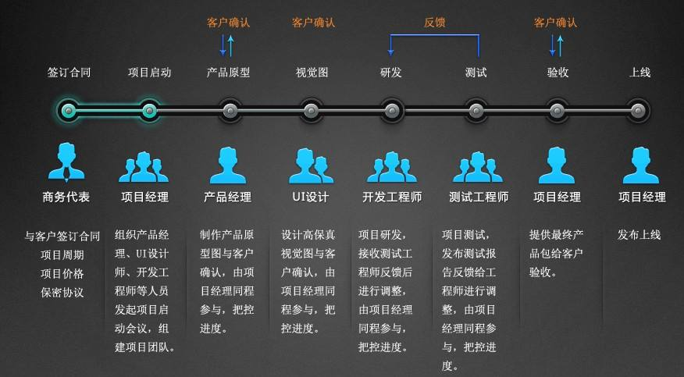
2. Mobile APP development process

Slide 8
2. Mobile APP development process
Demand analysis
Prototype design
UI Design
App development
Project testing
Release
Operation iteration
Routine maintenance

Slide 9
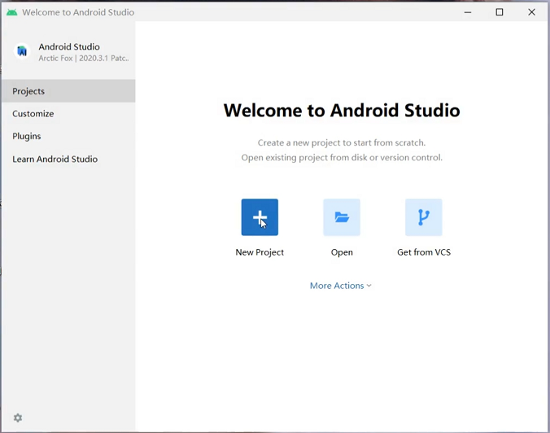
3. Introduction to Andriod Studio software
1) You will get the following window after you click the Android Studio icon on the desktop of your PC for the first time.
Click New Project

Slide 10
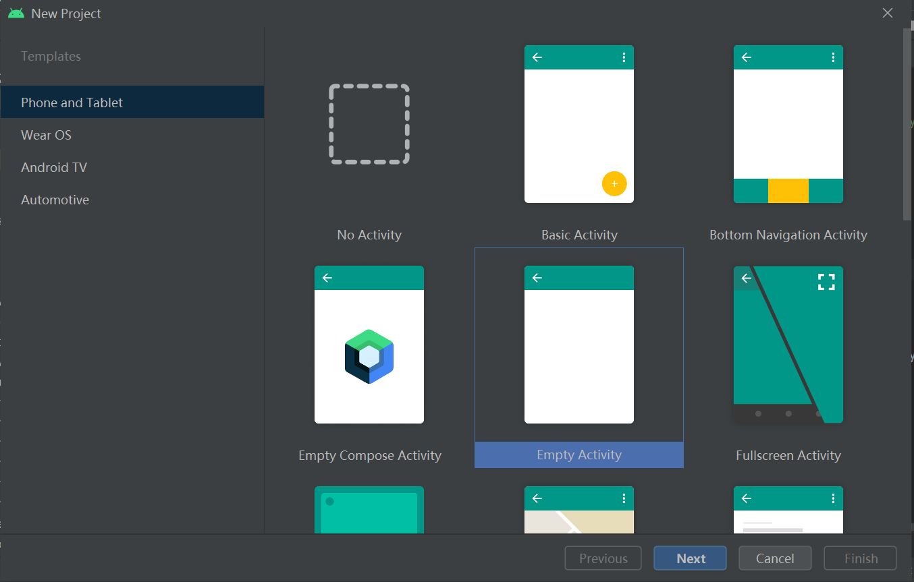
2) Please select Phone and Tablet and Empty Activity.

Slide 11
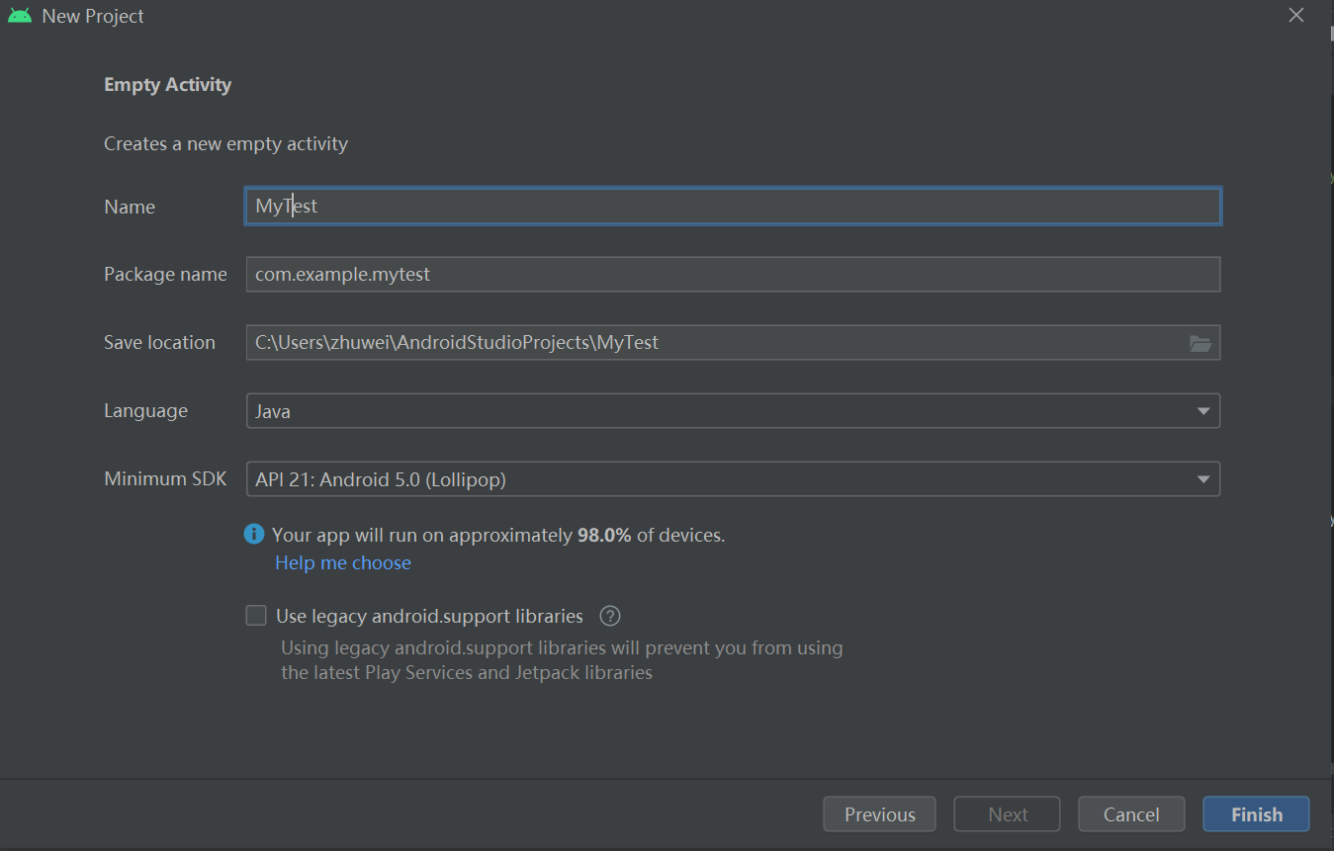
3) You will get the following window after you click Phone and Tablet and Empty Activity.
Enter a project name you like and easy to recognize the APP
Enter a package name that is unique.
You select (at least 10G space left in chosen disk).
Select Java.
Select default.
At last, click Finish.

Slide 12
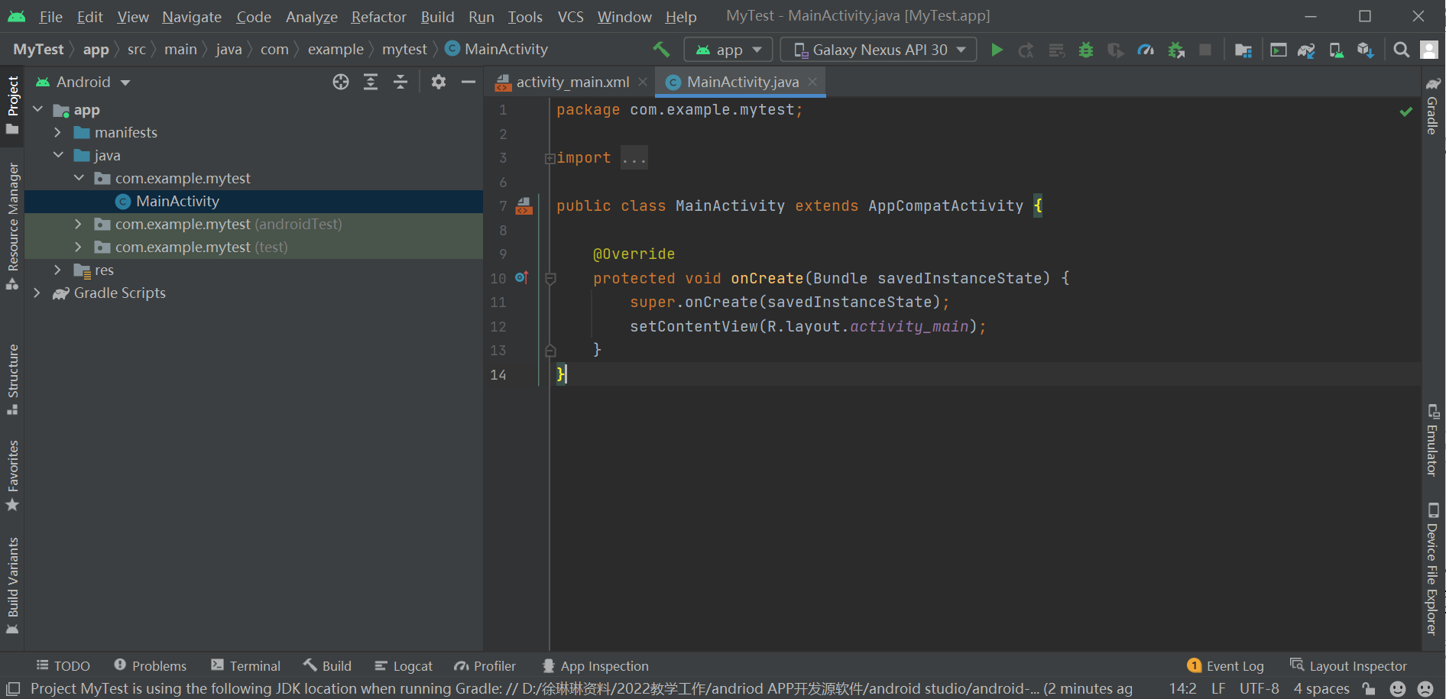
4) . After finish 3),you will get the following Android Studio interface window.
Layout window
Code window

Slide 13
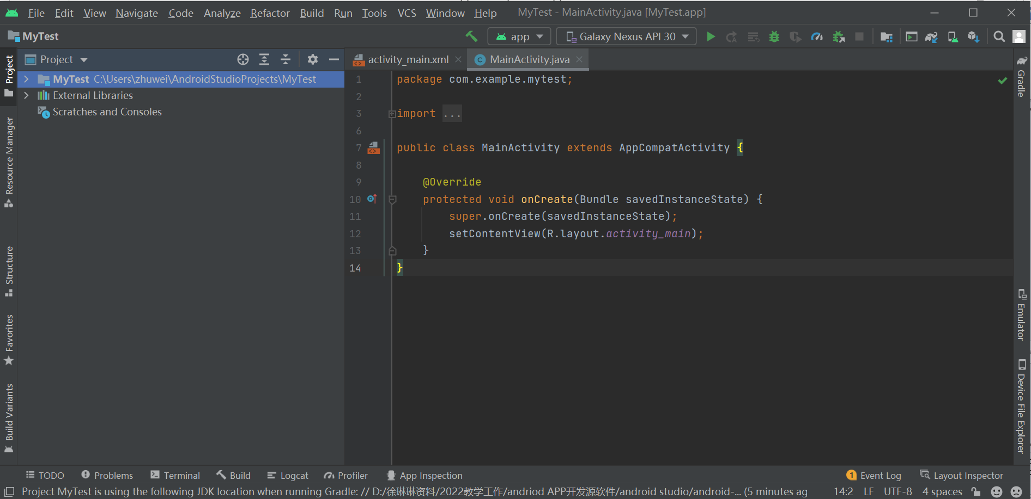
5) . Change to Project view

Slide 14
6) . Introduction to some important files
工程目录结构
视图编辑区
主界面逻辑代码编辑区
资源区
清单文件

Slide 15
4. Introduction to Android Studio layout and common controls
Introduction to Android Studio Layout
LinearLayout (commonly used )
RelativeLayout (commonly used )
GridLayout (sometime used )
FrameLayout
Constrained layout
... …

Slide 16
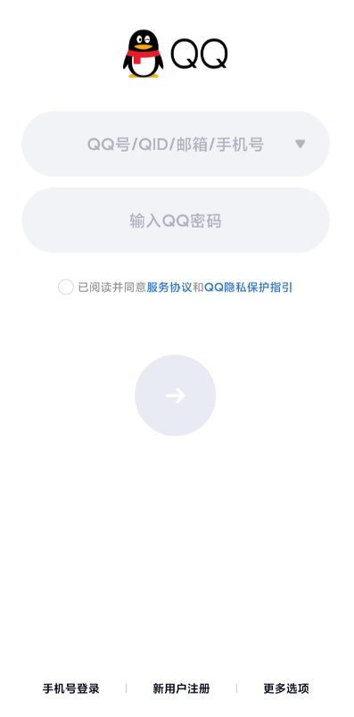
4. Introduction to Android Studio layout and common controls
Introduction to commenly used Android Studio Views
TextView
Button
EditText
ImageView
ScrollView/HorizontalScrollView
ImageButton
RadioButton
CheckEditView
CheckBox
… …
TextView的子类：EditText、Button、CheckBox、RadioButton等。

Slide 17
Properties of TextView（举例）
TextView是文本视图，显示的是文本。有如下属性：
layout_ width： 组件的宽度
layout. _height: 组件的高度
id: 为TextView设置- -个组件id
text: 设置显示的文本内容
textColor: 设置字体颜色
textStyle: 设置字体风格，三个可选值: normal(无效果)，bold(加粗)， italic(斜体)
textSize: 字体大小，单位一般是用sp
background: 控件的背景颜色，可以理解为填充整个控件的颜色，可以是图片
gravity: 设置控件中内容的对齐方向
layout_gravity：设置组件本身的位置
margin：视图外部周围留白
padding：视图内部周围留白
drawableleft/right:给TextView的框内的左/右添加图片
onclick：点击属性
.....

Slide 18
5. Course projects
Calculator App UI design
Menu UI design

Slide 19
6. Task
1) Install the Android Studio by yourself.
注意：1. 安装盘至少有30G的空间，并保证网速流畅
2. 先装JDK再装Android Studio
2) (Selective) Connect you own phone with the Android Studio,try to instal the APP you designed in the following courses on your phone .
3) （Selective）Complete Huawei application developer certification （Any time is OK ).
自行安排：
鸿蒙开发者认证官网：
https://developer.huawei.com/consumer/cn/training/dev-certification/a617e0d3bc144624864a04edb951f6c4

